Slide 1


Dr. N.G.P INSTITUTE OF TECHNOLOGY Department of CSE
WEEK-AHEAD WIND POWER FORECAST
BATCH MEMBER:
S.R. VIDHYAMBIKA,
UG Scholar, Dept of CSE,
Dr. N.G.P ITECH
GUIDE NAME:
Ms. R. Pavithra, M Tech, (Ph. D)
Assistant Professor (CSE)
Dr. N.GP ITECH

Slide 2

TABLE OF CONTENTS
Introduction
Problem Statement
Abstract
Objectives
Applications
Modules
Use Case Diagram
Data Flow Diagram
Tools for Implementation
Implementation
01
03
Literature Review
System Implementation
System Architecture
Functional block diagram
Methodology
02
04
Results & Discussion
Limitations
Conclusion & Future Work
Action Plan
References

Slide 3
INTRODUCTION
Wind energy is a very popular type of clean, affordable, renewable energy in which the energy or power is obtained from the force of the wind using wind turbines that transform kinetic energy into electrical energy.
More and more wind farms are being implemented these years because wind energy is a sustainable and valuable investment for the future.
According to the Global Wind Economic Council (GWEC), a total of 93 Giga Watts capacity of power-producing wind farms were newly installed in 2020.
According to the International Energy Agency (IEA), in 2021 the total wind capacity installed worldwide was 830 GW of which 93% were onshore wind farms and the remaining 7% were offshore wind farms.
These wind farms helped the world avoid over 1.2 billion tonnes of CO2 annually – equivalent to the annual carbon emissions of South America.
Wind power is a significant player in the production of energy due to its ability to achieve net zero and reduce global warming.
However, the biggest drawback of wind power is that it is unreliable due to unpredictable weather.

Slide 4
INTRODUCTION (Contd)
This creates dissatisfaction among the stakeholders / customers of wind energy producers.
Wind power forecasting comes into the picture to overcome this dissatisfaction and bridge the gap between demand and generation.
Results from wind power forecasting not only have a direct impact on bridging the gap between demand and generation, but also help in demand assessment, demand scheduling, planning, and utilizing other power resources if wind power cannot meet demanded power.
As per the grid code of Regulation 2010 and Deviation Settlement Mechanism (DSM) Regulation 2016 issued by the Central Electricity Regulatory Commission, New Delhi, India, all independent power producers must forecast their generation and submit a report on it to the Regional Load Dispatch Centre (RLDC).
In the event there is a deviation between the forecast and actual generated power, the renewable energy operators should pay the RLDC a penalty [1].
Wind energy producers can also benefit from forecasted results to avoid penalties under these regulations.

Slide 5

PROBLEM STATEMENT
“Any Windfarm owner needs a Wind energy forecasting software that not only forecasts value closest to the actual output value at the earliest (week-ahead) but also gives notifications in case of unexpected weather changes to meet their customer demands with more satisfaction so that their customers can purchase power from other resources in case of less or zero power generation due to any failures.”

Slide 6
OBJECTIVES
To develop a website for wind energy producers that forecasts wind power a week in advance so that demand can be planned and unforeseen failures can be handled sooner.
To use different machine learning algorithms and ensemble learning algorithms and compare them to find the most algorithm.
To use a dataset collected for several years.
To provide accurate week-ahead wind power forecasting.
To consider wind and weather parameters.
To forecast wind power closest to actual output with fewer error percentages.
To handle unexpected climatic changes and outages.

Slide 7

APPLICATIONS
Can be used for building new Windmills
Demand Scheduling
Improving existing grid
Assistance in grid management in matching and maintaining frequency.
Cluster Selection , De-selection

Slide 8
ABSTRACT
Wind power generation differs from conventional generation due to the stochastic nature of wind.
Thus, wind power forecasting plays a key role in dealing with the challenges of balancing supply and demand in any electrical system, given the uncertainty associated with the wind farm power output.
Accurate wind power forecasting reduces the need for additional balancing, trading energy and reserve power to integrate wind power.
This project proposes time-series forecasting using ensemble learning such as Random Forest Regressor, XGBoost regressor, CatBoostRegressor and other machine learning algorithms such as support vector regression, decision tree regression and linear regression.
And calculates the R2 score, MAE, RMSE values of all algorithms to make an accurate week ahead forecast.
The dataset collected on a wind farm for a period of two years is taken and used for training and testing the time-series forecasting models.
The dataset contains weather parameters like temperature, humidity, and pressure, wind parameters like wind speed and wind direction at the height of the wheel hub.

Slide 9
ABSTRACT (Contd)
The best week-ahead forecasting algorithms are found to be Random Forest Regressor, CatBoostRegressor and are then deployed as a website.
To handle unexpected problems, command signal can be sent to cluster – based connectivity of windmills and prior notifications can be sent to users through this website.
Thus, the forecasting results and these features will be useful in maximizing revenue to power producers while simultaneously benefitting the power utility as well as maximizing the sale of power output for wind power producers.

Slide 10
LITERATURE REVIEW
TITLE | DESCRIPTION | ADVANTAGES | DISADVANTAGES
Week-ahead Predictions of Wind Power Based on Weather Classification | Ding et al. [2] split the dataset and grouped it into five different clusters each showing a weather condition. The combined forecasting model is then formed using sparse Bayesian learning, kernel density estimation, and beta distribution estimation-based training. | Has less deviation value of 4.83% | It has high Normalized Root Mean Squared Error: 17.58, 19.96, 18.21 and Normalized Mean Arithmetic Error: 15.67, 17.43 and 16.45.
Wind power forecasting using ensemble learning for day-ahead energy trading | Exploratory data analysis was performed as it helps in understanding data for time-series forecasting [3]. After this step, models were created using linear regression, Bayesian ridge regression and support vector regression as well as with ensemble learning algorithms and with layers: Multi-Layer Perceptron (MLP) and Long Short-Term Memory (LSTM) | Reduction in a huge amount of energy trading to match demand | This model’s scope and accuracy grow after several years of feeding forecasted data back to the model Scope is limited to the day-ahead wind power prediction.

Slide 11
LITERATURE REVIEW (Contd)
Predicting the Energy Output of Wind Turbine Based on Weather Condition | Machine learning algorithms such as Random Forest Regressor, Support Vector Regressor, Decision Tree Regressor, Polynomial Regression, and Multi-Linear Regression were used to predict the wind power and the values were compared against actual output[4]. The model which gave the highest accuracy was Polynomial Regression with 95% accuracy. | Both weather and wind parameters were taken into account Highest accuracy obtained in prediction. | The scope of this research paper was limited to predict the energy output at that particular time
Forecasting Of Wind Turbine Output Power Using Machine Learning | In this paper, the output power of the wind turbines was predicted using the random forest regressor algorithm. The SCADA data was collected for two years from a wind farm located in France. The model was trained using the data from 2017.[5] The wind direction, wind speed and outdoor temperature were used as input parameters to predict output power. Then, the model was tested for two different capacity factors. The estimated mean absolute errors for the proposed model in this study were 3.6% and 7.3% for and 0.2 capacity factors, respectively. | Real-Time data collected and used as a dataset. High accuracy. | Climate varies from year to year due to external factors like global warming, and seasonal changes. Performed only day ahead forecast

Slide 12
LITERATURE REVIEW (Contd)
Day-Ahead Wind Power Forecasting Using Machine Learning Algorithms | Day-Ahead Wind Power Forecasting (WPF) is made using machine learning algorithms, i.e., multiple linear regression (MLR), decision tree (DT) and random forest (RF). The exactness of the model has been estimated utilizing three execution measurements to be specific: mean absolute error (MAE), mean outright percentage error (MAPE) and root mean square error (RMSE) [6]. To implement these models, wind speed and corresponding power data of four different sites from National Renewable Energy Laboratory (NREL) were taken and Random Forest algorithm outperforms the other 2 algorithms with low RMSE value. | Comparison is made by calculating accuracies and RMSE, MAPE and MAE for different Wind conditions Height of the windmill was taken as a parameter | The dataset used was real-time data collected from 2006 to 2007 and weather conditions have drastically changed over these years which will lower the accuracy when implemented for today’s wind farms

Slide 13
METHODOLOGY
This project proposed week-ahead wind power forecasting by performing exploratory data analysis, pre-processing the data, and using ensemble learning and machine learning models to perform time-series forecasting to predict wind power and deploy it as a website.
To handle unexpected climatic changes and outages, cluster-based connectivity of windmills via command signal and prior notifications are provided on the website.
The dataset used in this project is real-time data collected for two years on a wind farm from 2019-2020.
The algorithms used in this project with time series forecasting approach were: Random Forest regressor, XGBoost regressor, cat boost regressor, decision tree regression, support vector regression and multi-linear regression.
ADVANTAGES
Evacuating maximum power generated.
Wind Energy producers can avoid penalties under Deviation Settlement Mechanism (DSM) as per the grid code of Regulation 2010 which got amended in Regulation 2016 by the Central Electricity Regulatory Commission.
Bridging the gap between demand and generation.
Unexpected failures are handled in earlier stages.
Customer Satisfaction.

Slide 14
SYSTEM IMPLEMENTATION
Hardware requirements
PROCESSOR: Intel I5/ I7 Coffee Lake or AMD Ryzen 5 3600
HARD DISK CAPACITY: 1 TB
SOLID STATE DRIVE CAPACITY: 256GB (Optional)
INTERNAL RAM: 8GB (DDR4)
CPU CLOCK SPEED: 3.6 GHz
MONITOR RESOLUTION: 720p/1080p HD
GRAPHICS CARD: RTX-2080 Ti
GPU CLOCK SPEED: 1350 MHz
Software requirements
OPERATING SYSTEM: Windows 10/11
LANGUAGE: Python 3.7 or Higher
PLATFORM: Anaconda
SOFTWARE: Spyder / Google Colab
PYTHON LIBRARIES: Sklearn, Pandas, Numpy, Seaborn, Matplotlib
FRAMEWORK: Streamlit
CLOUD TECHNOLOGIES: Heroku/ IBM Cloud

Slide 15
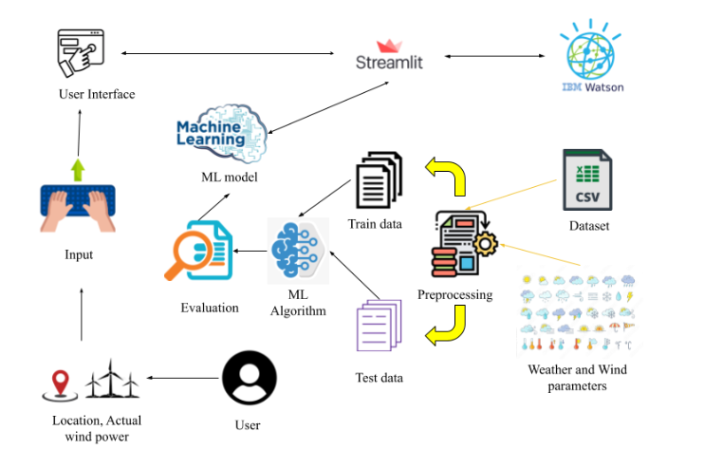
SYSTEM ARCHITECTURE DIAGRAM

Slide 16
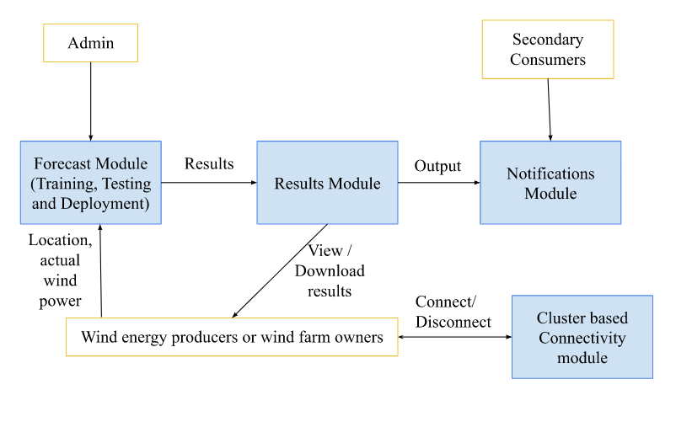
FUNCTIONAL BLOCK DIAGRAM

Slide 17
MODULES
This project consists of three modules which are as follows:
Admin Module – Forecast Module
Primary Consumer Module:
i) Results Module
ii) Cluster based connectivity module
Secondary Consumer Module – Notification Module

Slide 18
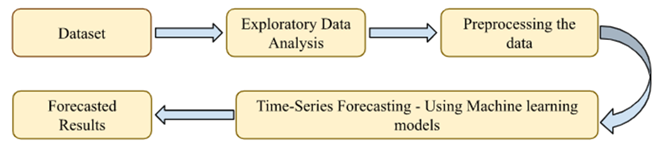
ADMIN MODULE – FORECAST MODULE
BLOCK DIAGRAM:

Slide 19
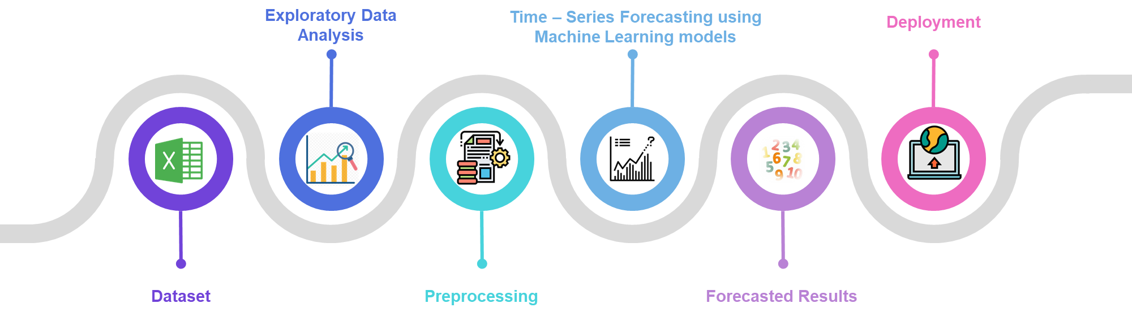
FORECAST MODULE

Slide 20

FORECAST MODULE - DATASET
The week-ahead wind power forecasting dataset is obtained from the Figshare repository[22].
This dataset is real-time data collected in the London wind farm once every 15 minutes over a period of two years.
Required parameters such as Date and Time, Temperature, Humidity, Atmospheric Pressure, Wind direction and speed at the height of the wheel hub, and Actual power measured were used to train the machine and ensemble learning models in time-series forecasting.
The dataset is checked for null values and if present, they are removed from the dataset.

Slide 21


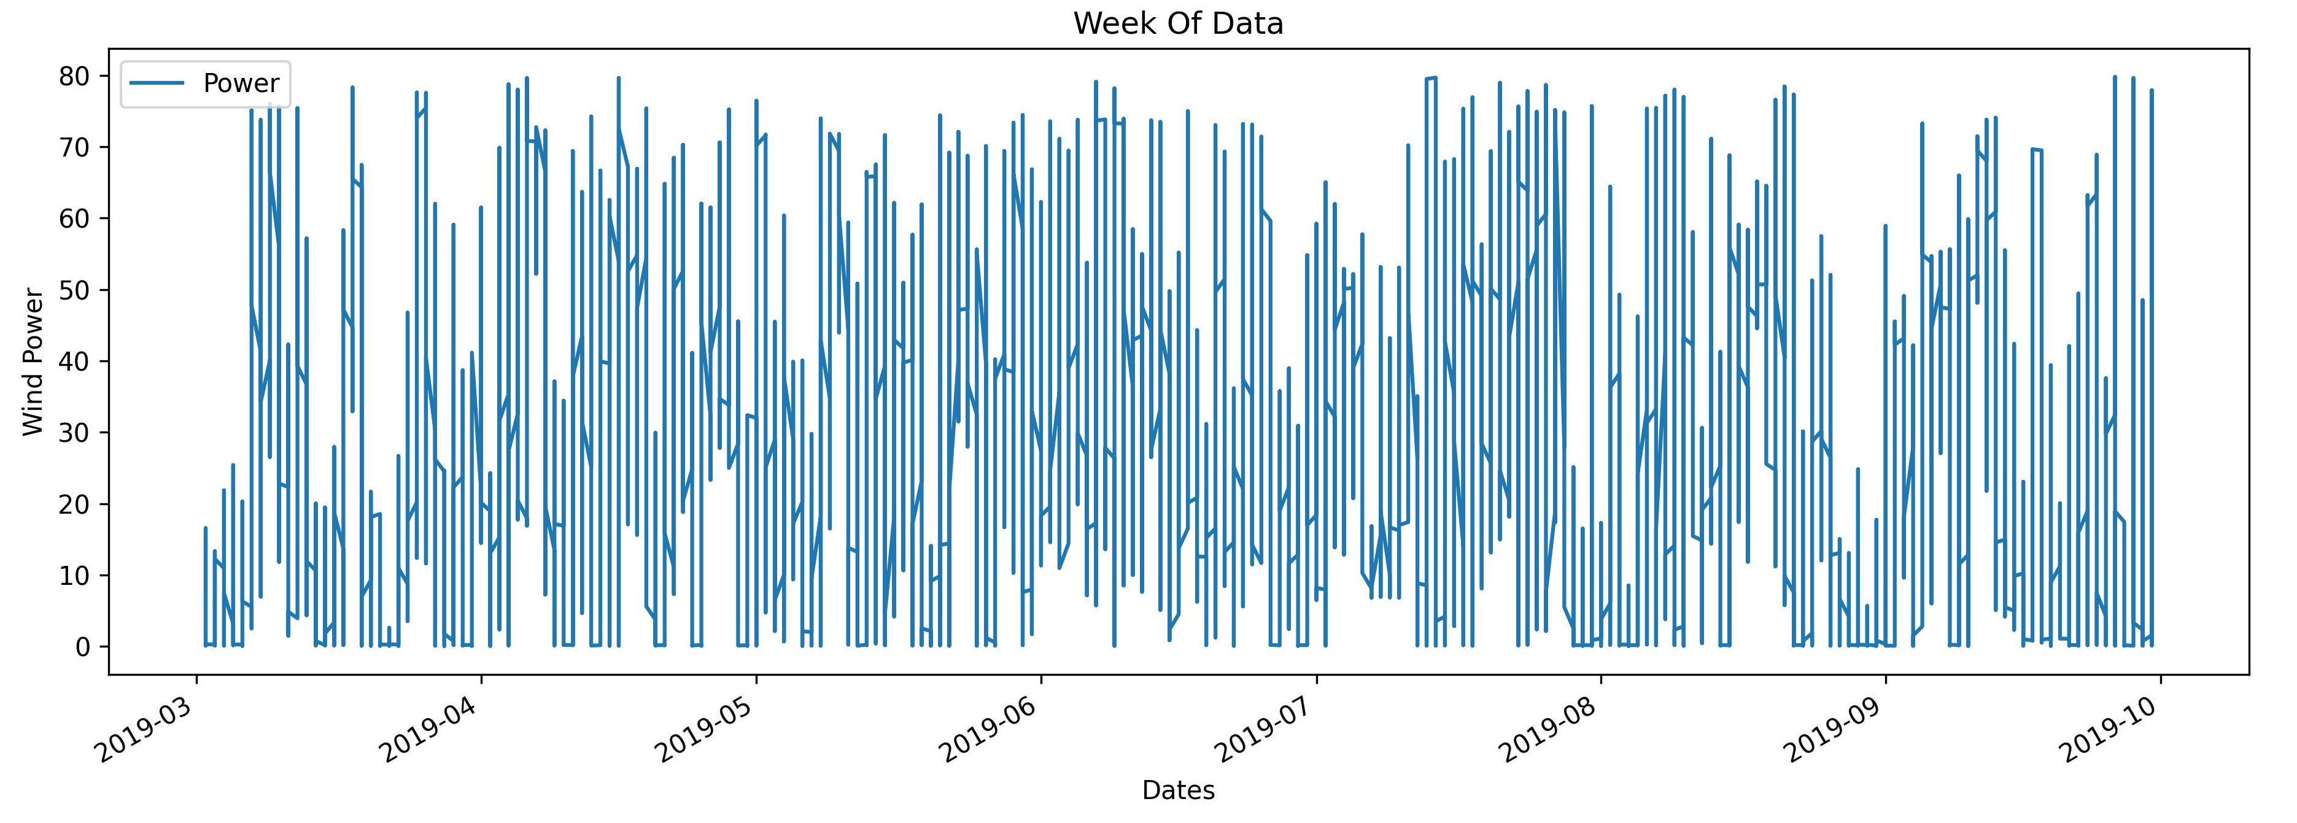
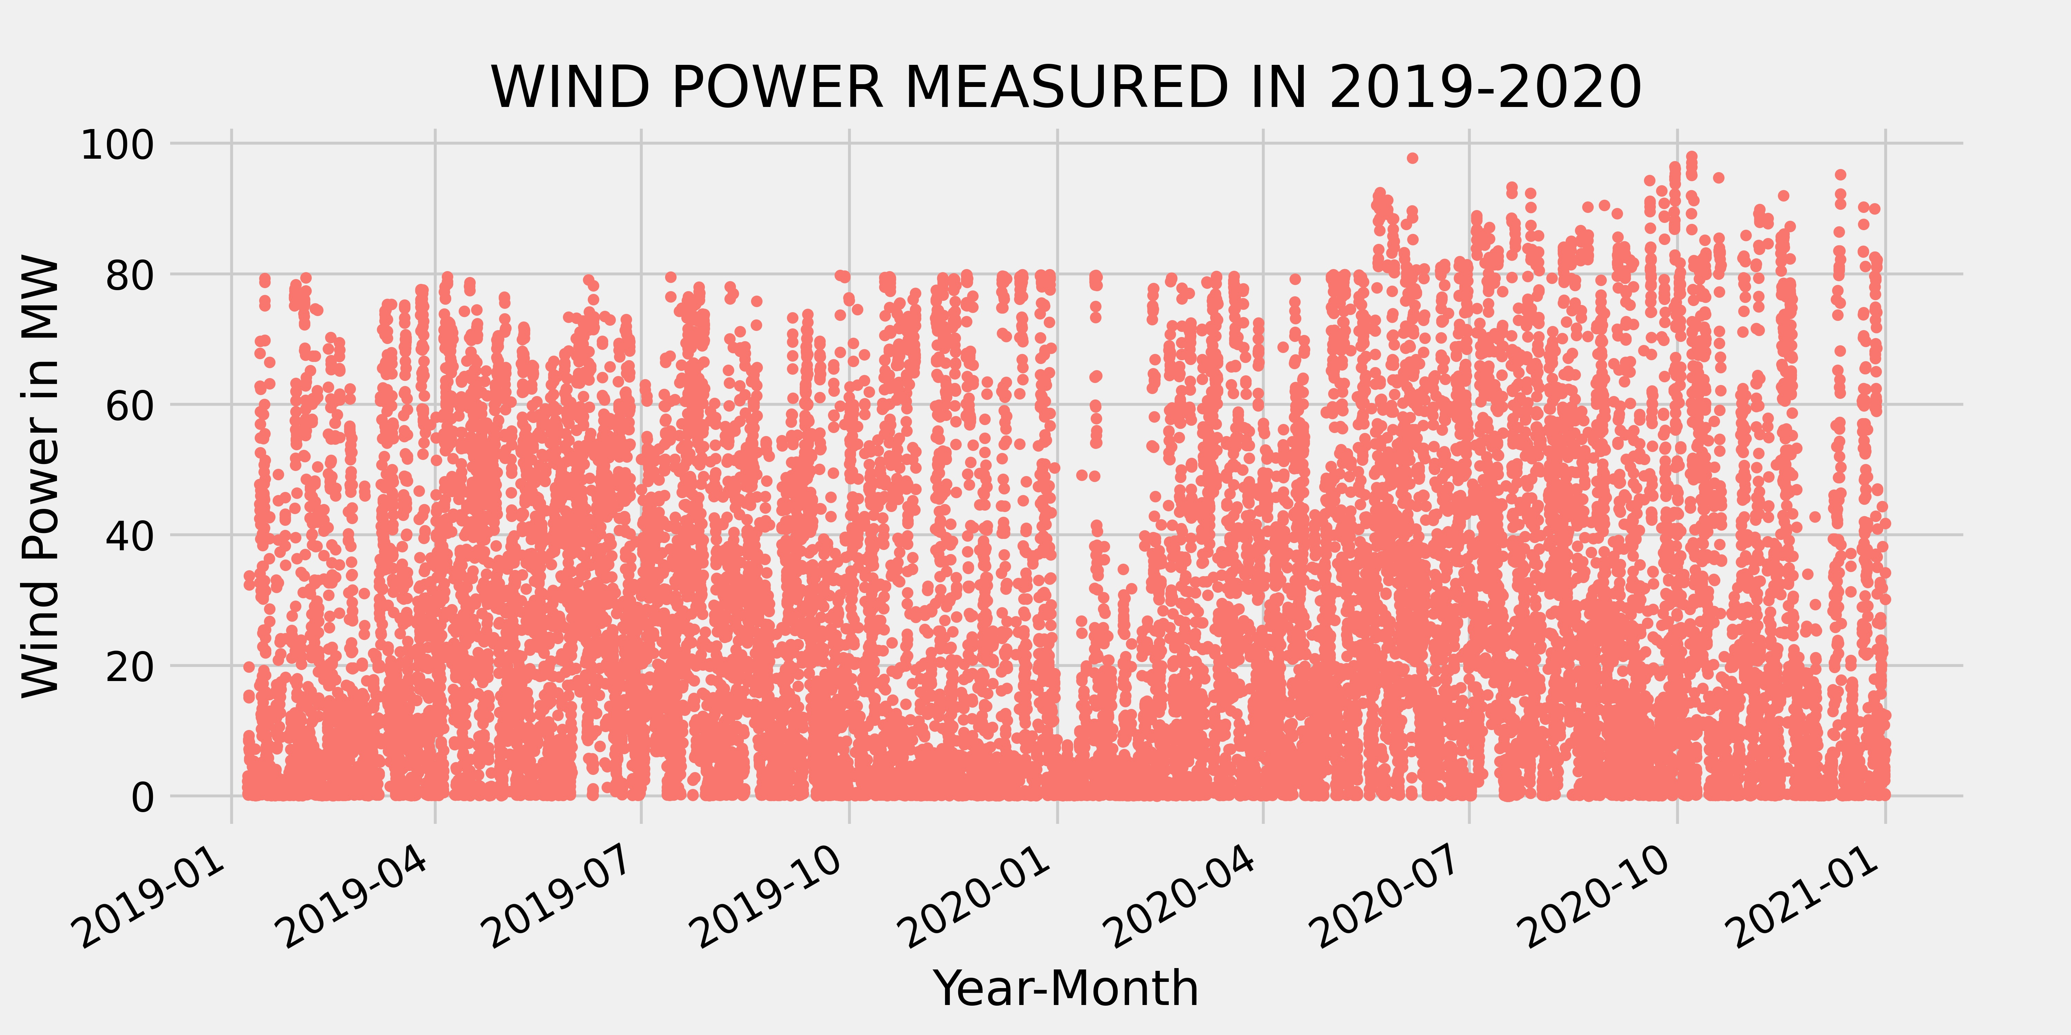
FORECAST MODULE - EDA
Exploratory Data Analysis (EDA) is used to analyze the dataset to find and summarize main characteristics, discover seasonality, patterns and trends, and also to visualize the data.
The complex seasonality of wind power observed over a week from 03-01-2019 to 10-01-2019 in the dataset is visualized. Wind power seasonality is complex due to inconsistent wind.
The similarity between wind power measured in the same month in two years is also visualized below.

Slide 22
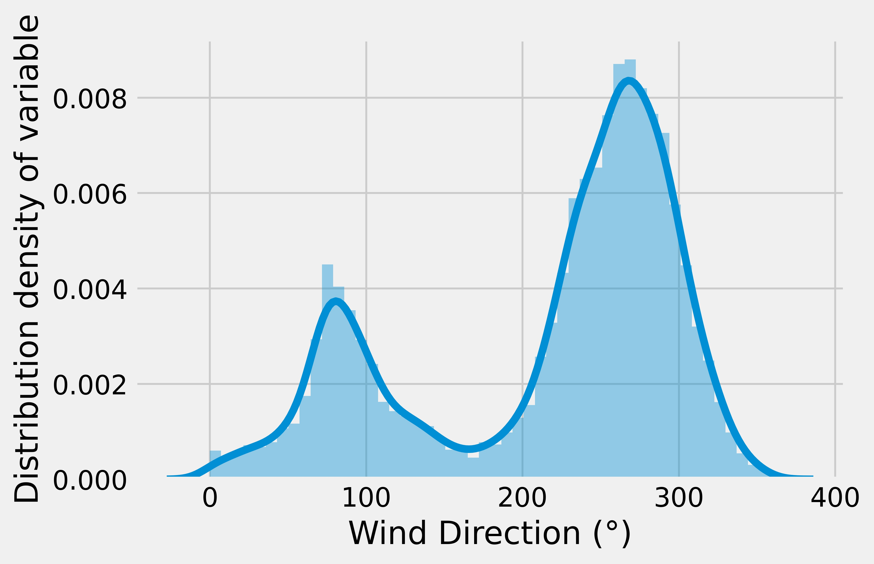
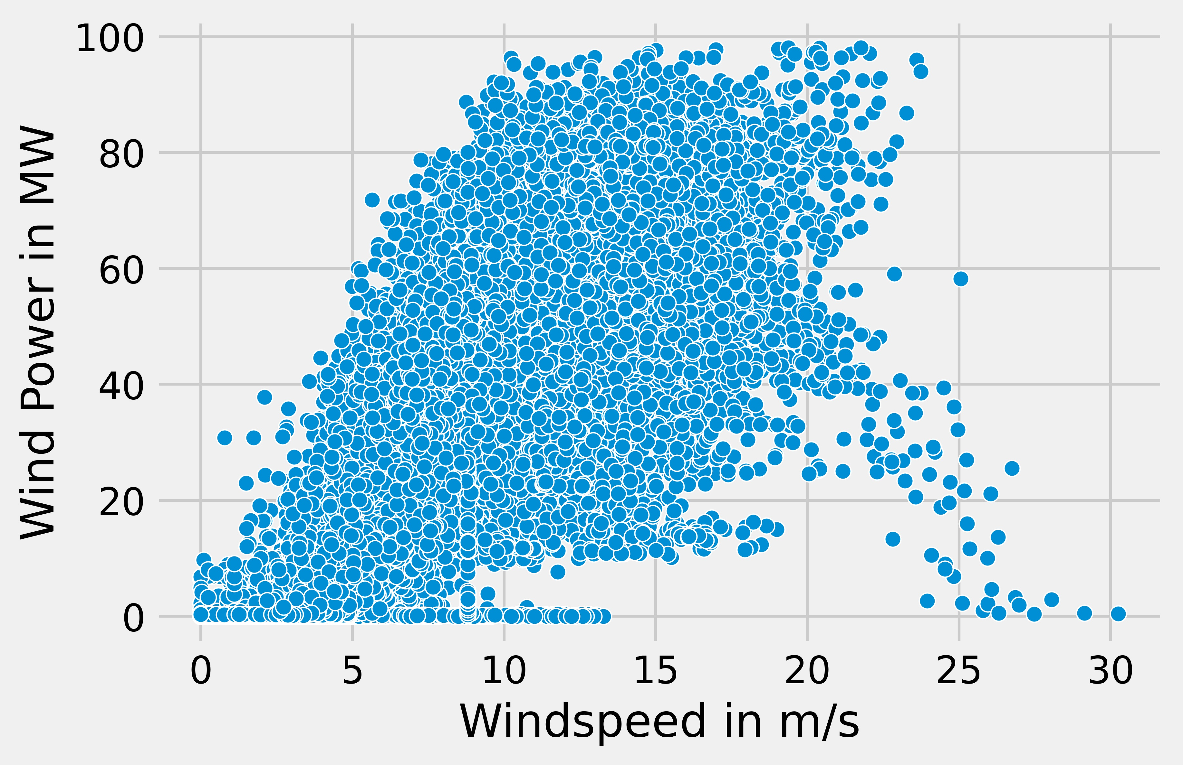
FORECAST MODULE – EDA (Contd)
UNIVARIATE ANALYSIS
Univariate analysis analyzes each individual parameter.
The univariate analysis made for the parameter wind direction using a distribution plot.
This provides the variation in the distribution of values.
BIVARIATE ANALYSIS
The high positive correlation between the parameters: wind speed and observed power is determined by performing bivariate analysis using a scatter plot.
The power parameter has multiple possible values for each wind speed and in correlation, some outliers are present.

Slide 23
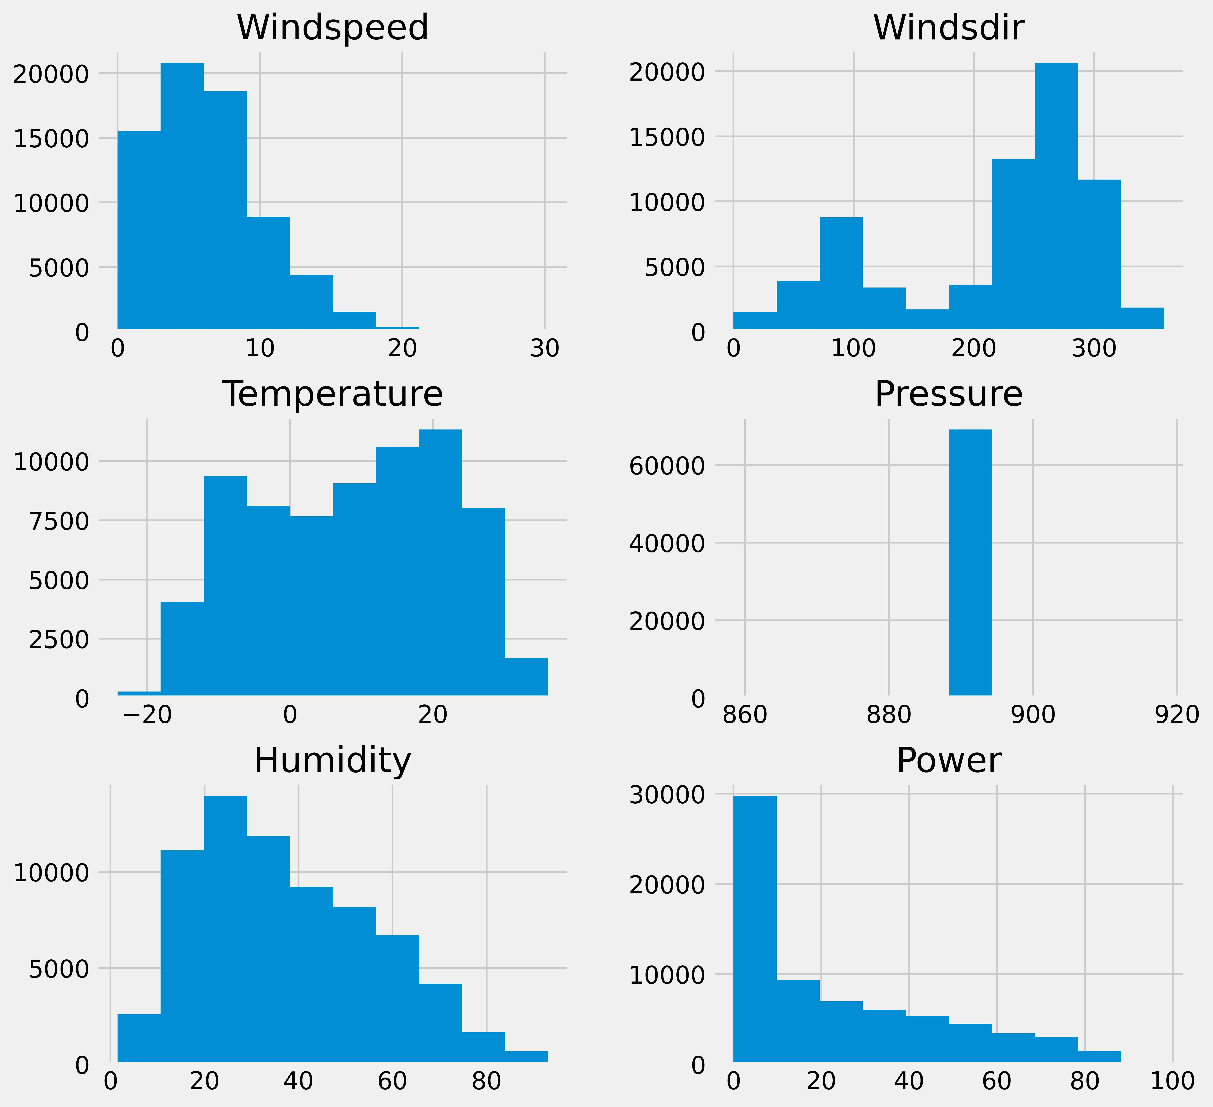
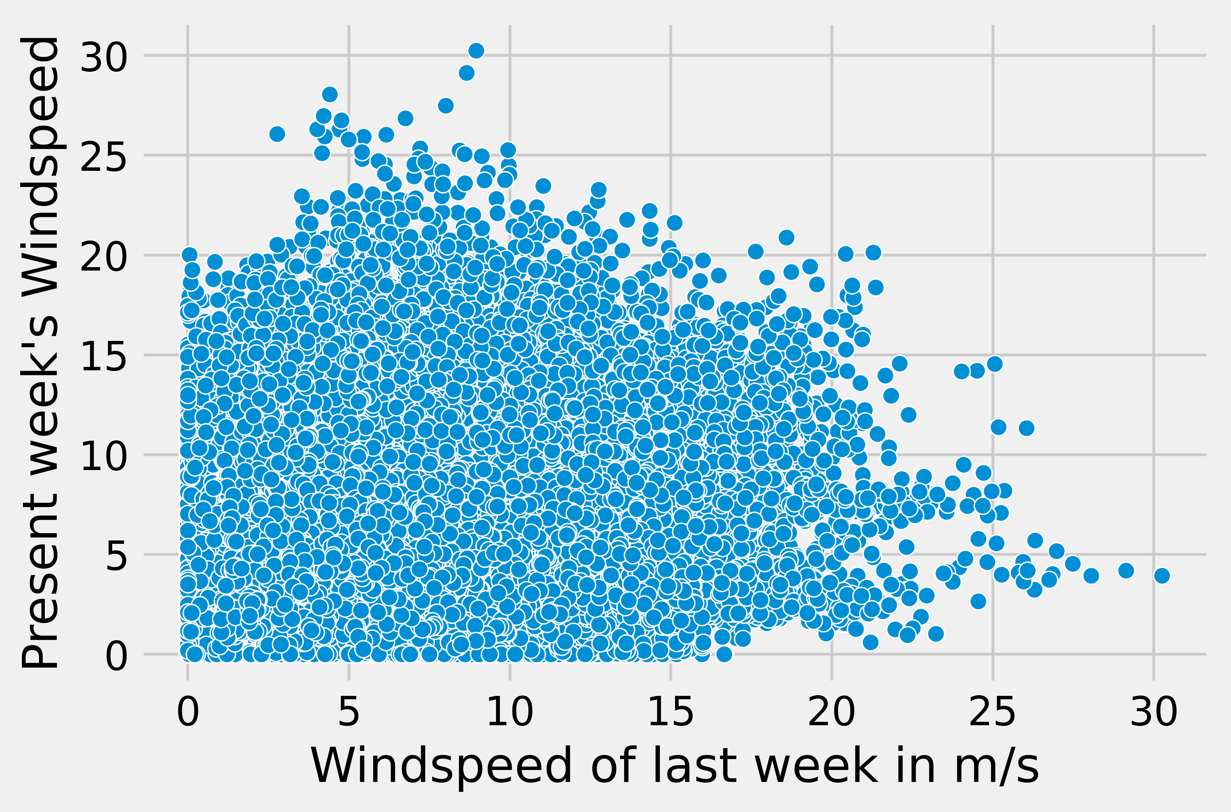
FORECAST MODULE – EDA (Contd)
BIVARIATE ANALYSIS (Contd)
The relationship between the two parameters, viz., the present wind speed flowing in the wind farm and that of the previous week are observed using a scatter plot.
It also shows that the present week’s wind speed is dependent on the previous week’s wind speed because of the weather but it has several possibilities for each last week’s wind speed value..
MULTIVARIATE ANALYSIS (Contd)
The histogram uses the concept of bins, gives a deep understanding of each parameter in the dataset, and shows the distribution of data in each parameter.

Slide 24
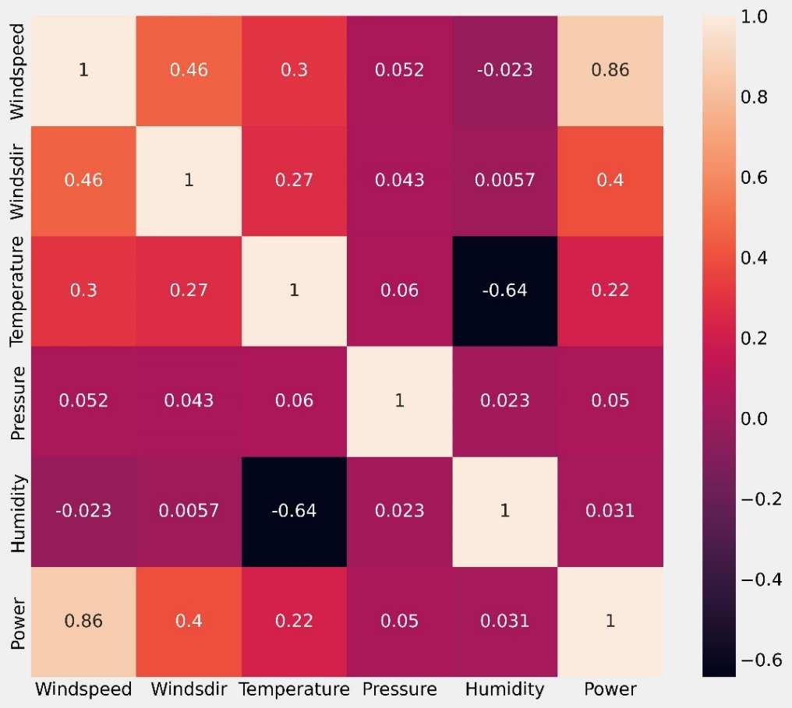
FORECAST MODULE – EDA (Contd)
CORRELATION HEATMAP
The correlation heat map provides a visualization of the relationship between the numerical parameters taken. This correlation heat map is used for linear and non-linear relationships among the parameters. From the correlation map made, it is evident that:
Wind speed and Observed power have a high positive correlation and a slight change in wind speed significantly impacts the power measured.
Temperature is inversely propositional to humidity and has a high negative correlation in the heat map.

Slide 25

FORECAST MODULE – PREPROCESSING & TIME SERIES FORECASTING
Now, the dataset is modified to perform time-series forecasting by adding these weather parameters: Temperaturelastweek, Humiditylastweek and Pressurelastweek, and wind parameters: Windspeedlastweek, Windsdirlastweek using the data already present within the dataset.
The NotaNumber (NaN) values generated due to the addition of these parameters are removed. Then, the dataset is preprocessed and split into training and testing data where testing data has 30% of the original dataset. Then using a standard scaler, the data is scaled for making predictions.
A total of six Ensemble and Machine Learning algorithms namely, Random Forest regressor, XG boost regressor, cat boost regressor, support vector regression, decision tree regressor and multi–linear regression are trained and tested in time series forecasting approach with the data for a week-ahead wind power forecast.

Slide 26
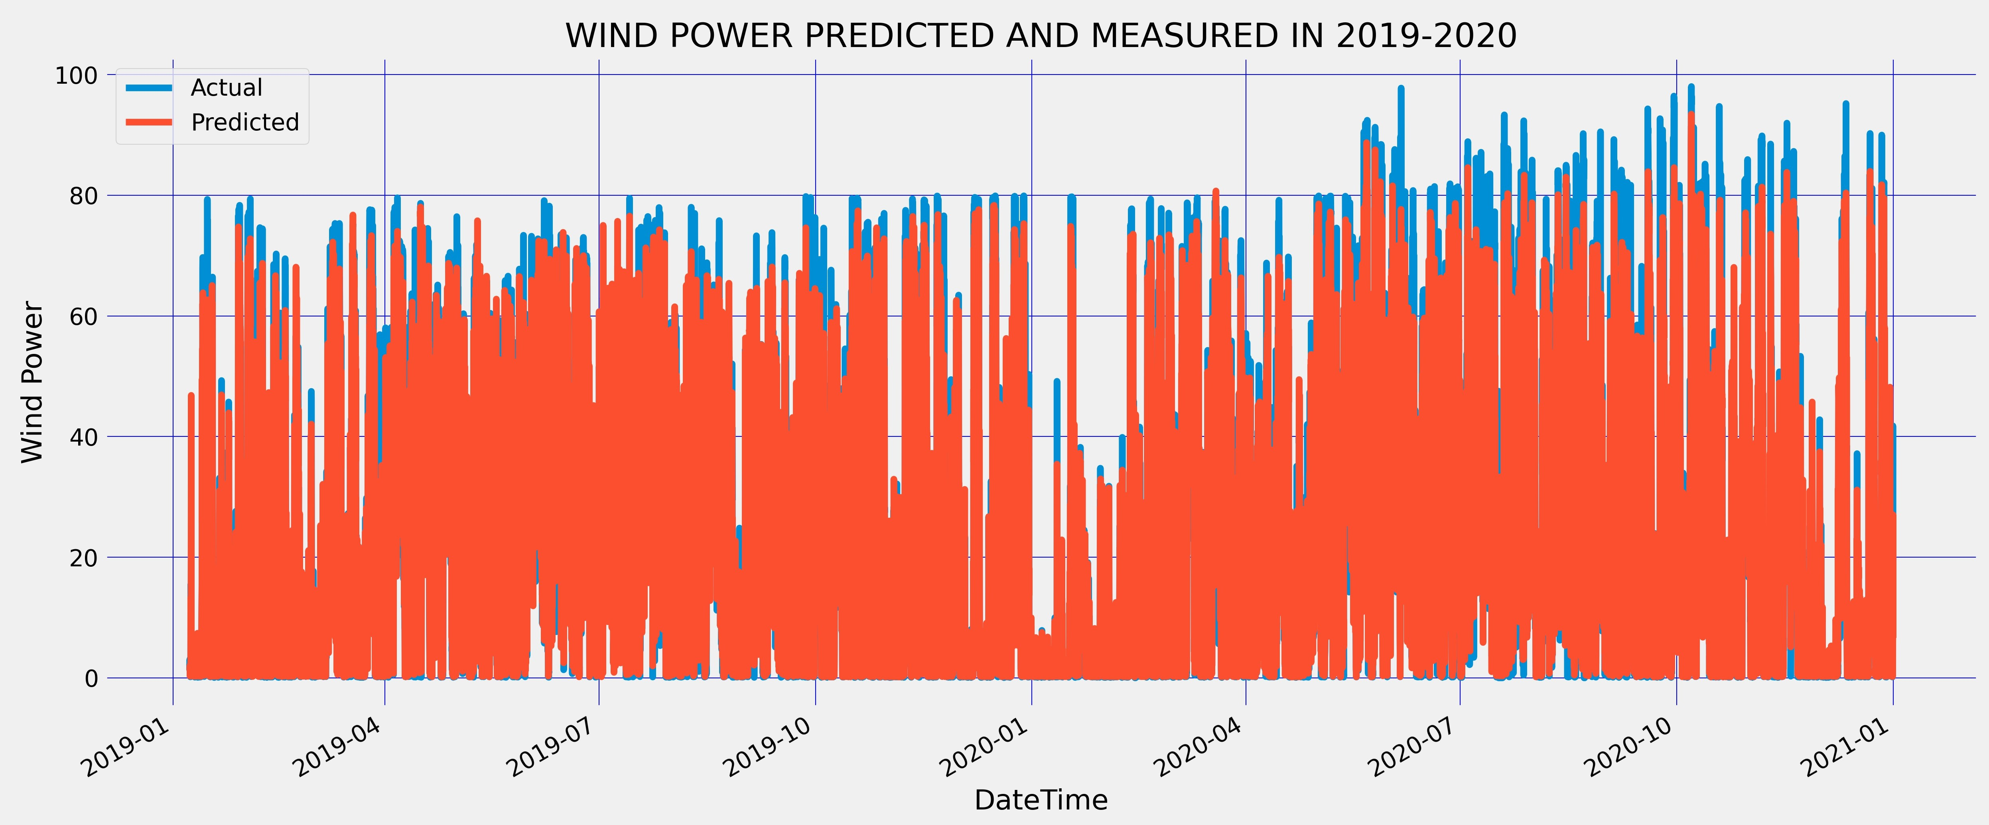
FORECAST MODULE (Contd)
RANDOM FOREST REGRESSOR:
Random Forest regressor employs an ensemble learning method which integrates predictions from many decision trees, to obtain a more accurate prediction and bagging approach to reduce variance in decision trees.
In week-ahead wind power forecasting, this algorithm is used because it captured the seasonality of the data effectively and predicted the value closest to the actual output.
But, using many decision trees can slow down the algorithm and reduce its accuracy. Thus, the algorithm was taken with the number of estimators as 30, and the random state as 0. It gave the highest accuracy among all other algorithms within a short period of learning and examining the data.

Slide 27
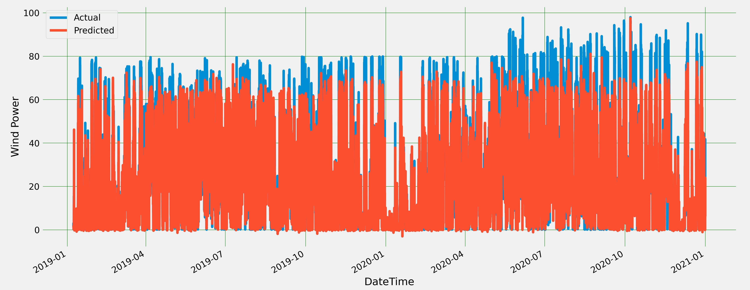
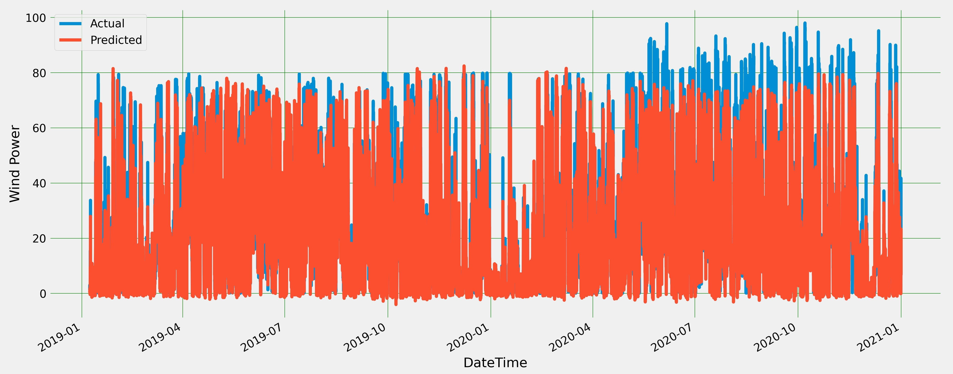
FORECAST MODULE (Contd)
2) XG BOOST WITH HYPERPARAMETER TUNING:
The Extreme Gradient Boosting Regressor, or XGBoost regressor, is an efficient gradient-boosting implementation.
In wind power forecasting, XGBoost is used with hyperparameter tuning which gives the best learning rate, number of estimators, and maximum depth and it produced accurate forecasts, but training with data took a long time.
Accuracy decreases by approximately 1.5% if hyperparameter tuning is not used.
3) SUPPORT VECTOR REGRESSION:
Support vector regression works on a similar principle as support vector machines: finding the best-fit line, which is the decision boundary line with the most points.
This allows us to choose how much error in our model is acceptable, find a suitable line (or hyperplane in higher dimensions) to fit the data and get a precise week-ahead forecast.

Slide 28
FORECAST MODULE (Contd)
4) CATBOOST REGRESSOR:
CatBoost expands on gradient-boosted tree theory. Gradient boosting sequentially fits the decision trees and allows them to learn from and minimize the variance of earlier trees.
Additional functions, or trees, are continuously added to the already existing ones until the selected loss function is no longer minimized which takes a very long time.
CatBoost, however, deviates from these gradient-boosting models. CatBoost generates oblivious trees formed by imposing the constraint that all nodes at the given level test the same predictor under similar circumstances.
As a result, a leaf's index can be determined using bit-wise operations.
While the tree structure serves as a normalization to determine the best solution and avoid overfitting, this algorithm also provides an effortless fitting strategy and is more effective on CPUs.
In the week ahead wind power forecast, this algorithm took less time to train than XG Boost and gave prediction values closest to the actual output like random forest regressor.
DECISION TREE REGRESSOR:
Decision tree regression is used to observe the characteristics and train a tree-based algorithm to predict the target value and produce meaningful continuous output.
It does so by incrementally developing a related decision tree as it segments a dataset into smaller chunks.
The decision tree produces a tree with leaf nodes and decision nodes, with the root node being the most accurate predictor.
A decision node has two or more branches, each of which represents a possible value for the property under test.
The leaf node represents a decision on the numerical output parameter. This algorithm is used in wind power forecasting to understand the pattern in data and to get an accurate, continuous forecast.
But, a slight change in the data creates a major shift in the decision tree’s structure, giving results completely different from what is expected.

Slide 29
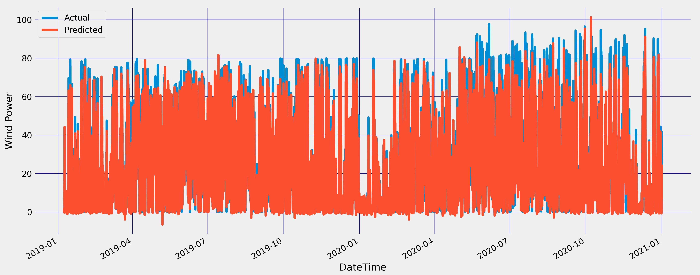
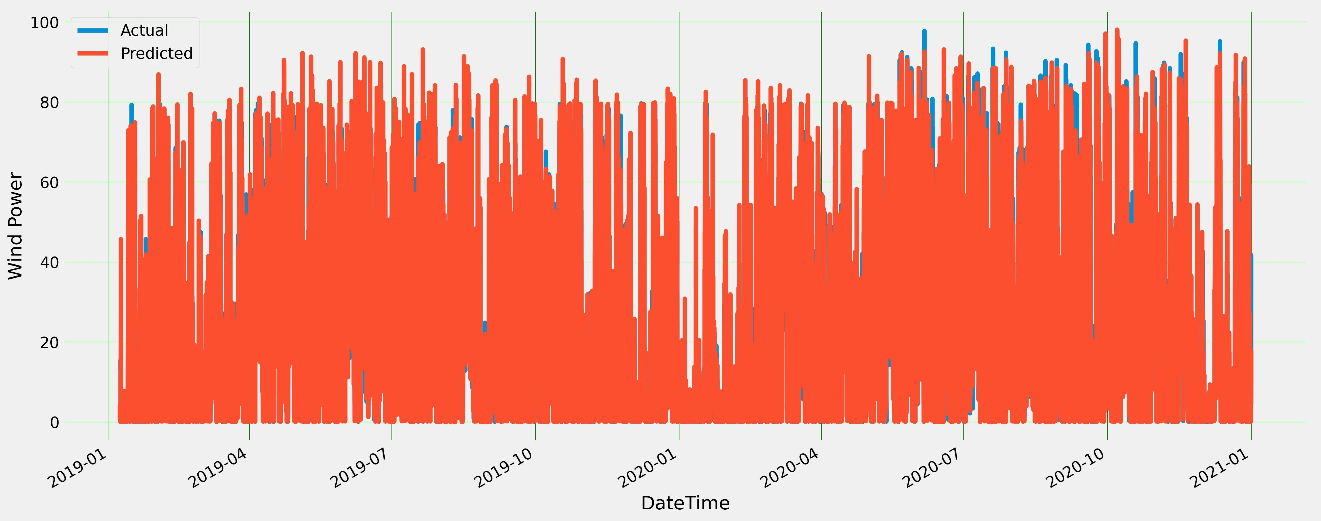
FORECAST MODULE (Contd)
4) Comparison of predicted and actual values for Cat Boost Regressor
5) Comparison of predicted and actual values for Decision Tree Regressor

Slide 30
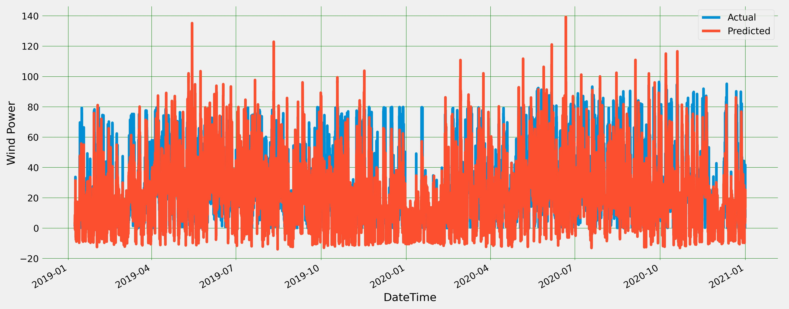
FORECAST MODULE (Contd)
6) LINEAR REGRESSION:
Multiple – Linear Regression is one of the most widely used supervised learning methods.
It is used in forecasting wind power as it takes several explanatory variables which are independent in nature to predict the output which is dependent in nature. But it does not automatically take care of non-linearity in data, so it negatively impacts accuracy.

Slide 31
USER MODULE
RESULT MODULE:
Users can view and download the forecasted wind power results easily in Portable Document Format (PDF) or Joint Photographic Group (JPG) i.e., .jpg form.
NOTIFICATION MODULE:
Users (Wind Energy Producers) can send notifications to their customers (Secondary Consumers) if demanded power cannot be met due to unexpected weather changes or outages (including unplanned maintenance or repair work). Notifications can be sent through mail or as mobile phone notifications.
CLUSTER BASED CONNECTIVITY MODULE:
Users can connect a group of windmills in single or multiple wind farms as a cluster to handle unexpected weather and outages. This prevents the situation of excess power as power generated cannot be stored or fixes the shortage of power. Clusters are formed based on demand from consumers or near-far windmills or windmills that are not under maintenance. Switching off/on windmills in clusters is accomplished through a command signal.

Slide 32
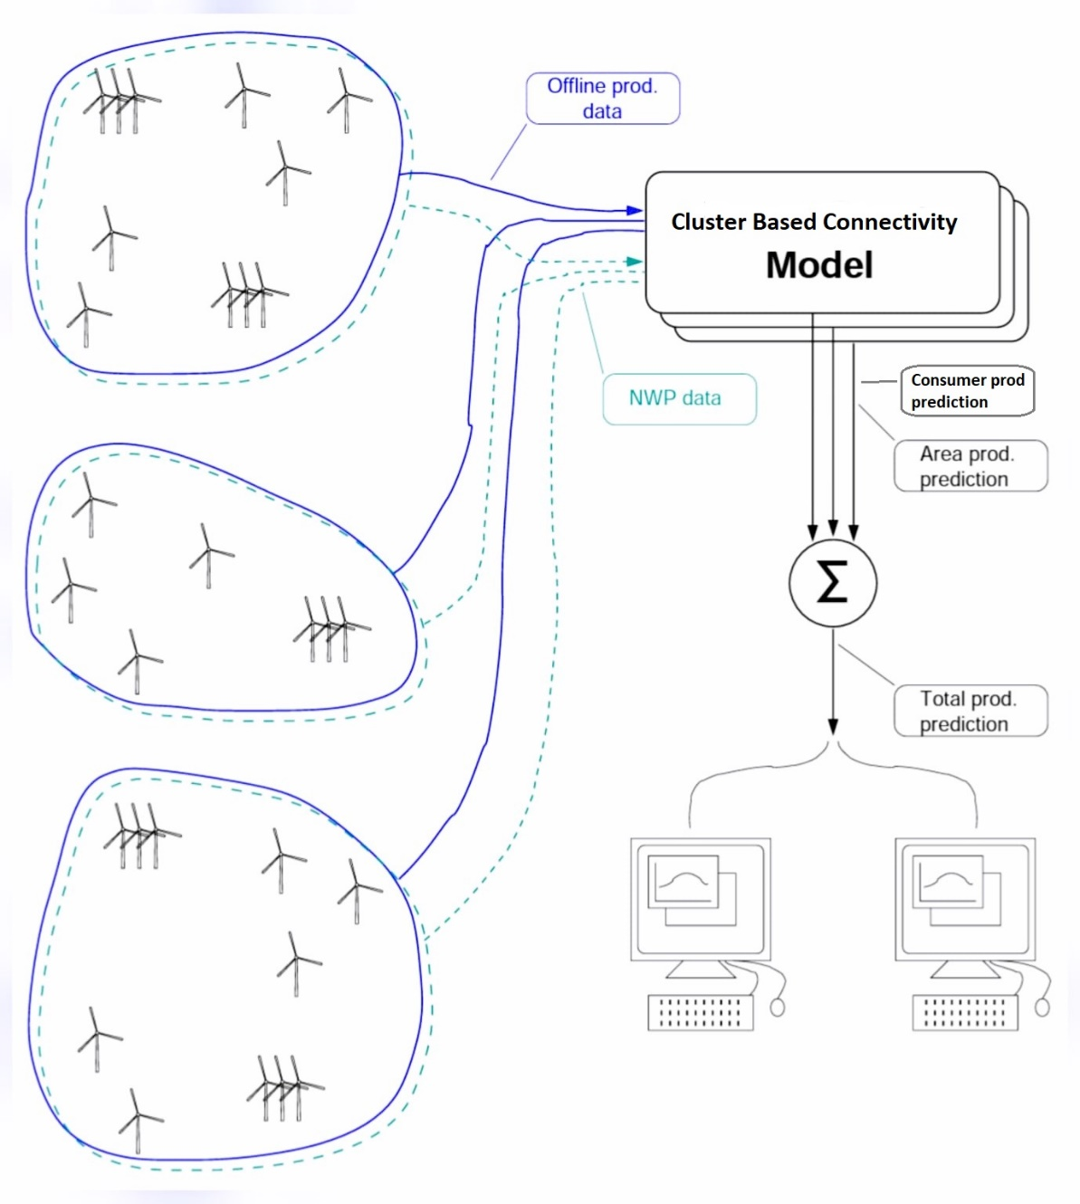
USER MODULE-CLUSTER BASED CONNECTIVITY (Contd)

Slide 33
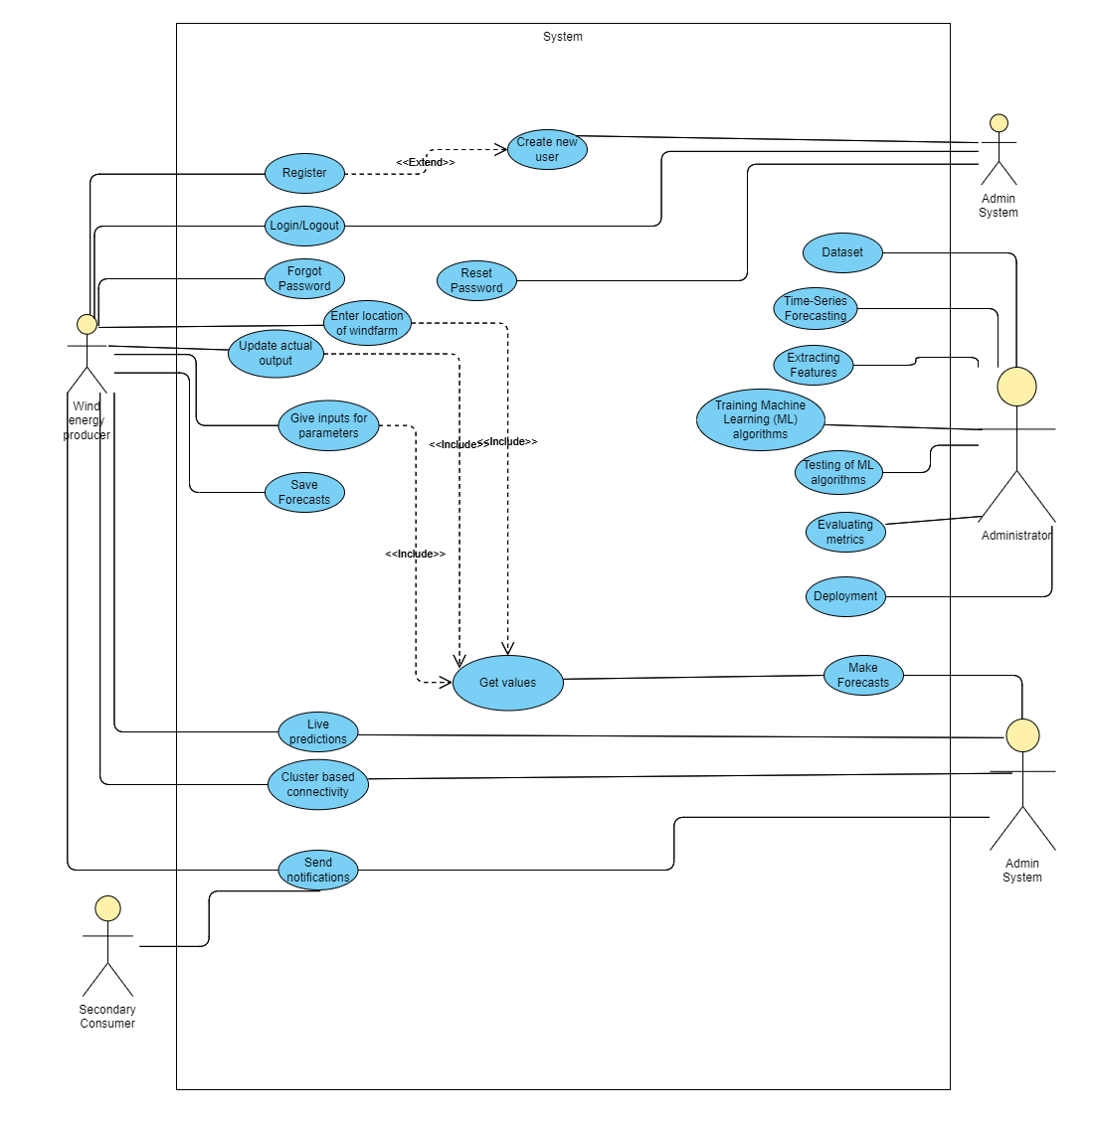
USE CASE DIAGRAM

Slide 34
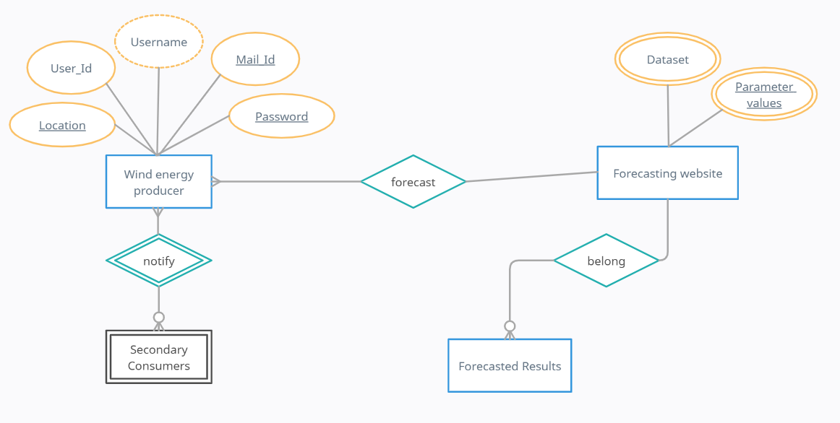
ER DIAGRAM

Slide 35
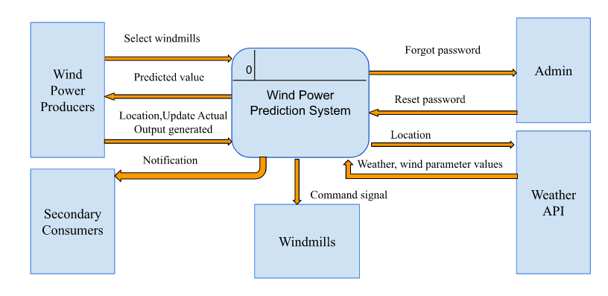
DFD DIAGRAM – LEVEL 0

Slide 36
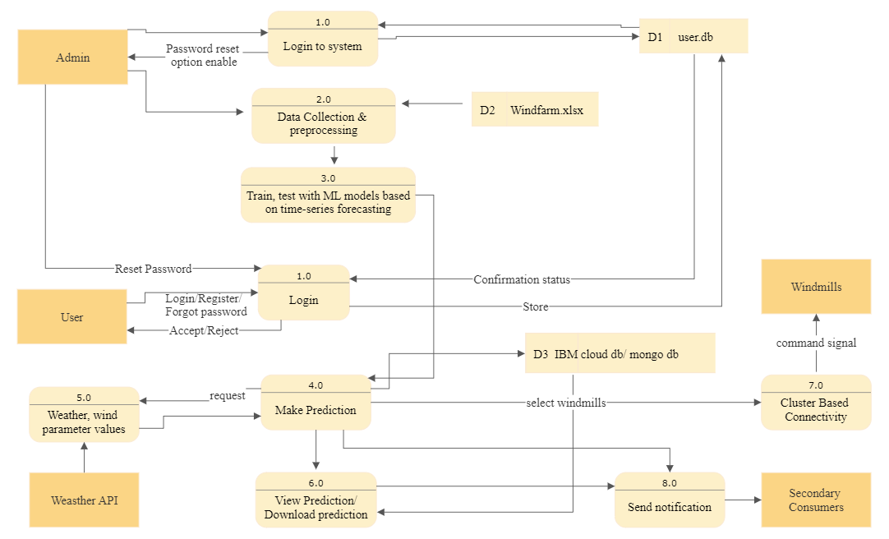
DFD DIAGRAM – LEVEL 1

Slide 37
TOOLS FOR IMPLEMENTATION
Jupiter Notebook / Google Colab
1
4
Open Weather API
Spyder with Streamlit
2
5
Python Libraries used: Seaborn, Matplotlib, Pandas, Numpy, Sklearn
IBM Watson Machine Learning
3
6
Languages used: HTML, CSS, Javascript and Python

Slide 38
RESULTS
The week ahead wind power forecasting was implemented using Time Series Forecasting using ensemble learning and machine learning.
The R2 score measures the average distance between the predicted values and the actual values in the test dataset. It was measured to find the most accurate model.
Additionally, Root Mean Square Error (RMSE) and Mean Absolute Error (MAE) were computed to find the erroneous which is difference in actual and predicted values.
RMSE is a useful metric because it penalizes large errors more heavily than small errors since the squared differences are used in the calculation. It also has the same unit as the dependent variable, which makes it easy to interpret.
RMSE = sqrt (mean ((y_true - y_pred) ^2))
MAE measures the average absolute difference between the predicted values and the actual values in the test dataset.
MAE = mean(abs(y_true - y_pred))

Slide 39
RESULTS (Contd)
The R2 score, RMSE and MAE values measured for all algorithms are shown in below table.
In this, Random Forest Regressor outperformed all other algorithms and gave the best R2 score and the least RMSE and MAE values.
Comparison of R2 score, RMSE score and MAE score of all algorithms
ALGORITHM | R2 SCORE | RMSE | MAE
Random Forest Regressor | 0.9097 | 7.288 | 4.546
XGBoost Regressor - With Hyperparameter tuning | 0.8776 | 8.482 | 5.259
XGBoost Regressor - Without Hyperparameter tuning | 0.8618 | 9.016 | 5.595
CatBoost Regressor | 0.9073 | 7.384 | 4.711
Support Vector Regression | 0.8312 | 9.964 | 6.144
Decison Tree Regressor | 0.8218 | 10.237 | 6.0433
Multi-Linear Regression | 0.7518 | 12.082 | 8.5178

Slide 40

LIMITATIONS
No electricity when there is no wind, very high wind.
Suggestions given in the web app for installing wind turbines based on location are limited areas as high wind power can be generated only in certain areas.
Weather is unpredictable as there are a lot of factors that affect weather.
Selling power produced through wind farms.
Power generated can’t be stored.

Slide 41
CONCLUSION AND FUTURE WORK
It is difficult for wind farm owners and wind energy producers to evacuate maximum energy to the grid or their customers with short-term forecasting, achieve customer satisfaction and avoid penalties.
Thus, week ahead wind power forecast with time series forecasting using ensemble and machine learning is proposed.
Among the proposed algorithms random forest algorithm gave the highest accuracy with less error value.
Therefore, it is deployed as a web app using Streamlit and integrated with the main website.
In future, this work can be extended by including windmill specs as parameters in the dataset to train the algorithms and provide users with individual and cumulative week-ahead forecasts for all windmills in wind farms.
In future, this work can be extended by adding windmill height and wind turbine specifications as parameters in the dataset to train the algorithms and provide users with a customized week-ahead forecast for their wind farms.

Slide 42
REFERENCES
[1] S. Gireesh, B. Pradhan, C. Shri, A. Singhal, S. Bakshi, and M. Iyer, “STATEMENT OF REASONS Central Electricity Regulatory Commission (Deviation Settlement Mechanism and Related Matters) (Third Amendment) Regulations, 2016,” 2016. Available at: https://cercind.gov.in/2016/regulation/SOR123.pdf
[2] T. Ding, M. Yang, Y. Yu, and F. Yan, “Week-ahead Predictions of Wind Power Based on Weather Classification,” 2020 IEEE/IAS Industrial and Commercial Power System Asia (I&CPS Asia), Jul. 2020, pp. 623-631, doi: 10.1109/icpsasia48933.2020.9208458.
[3] A. L. Suárez-Cetrulo, L. Burnham-King, D. Haughton, and R. S. Carbajo, “Wind power forecasting using ensemble learning for day-ahead energy trading,” Renewable Energy, vol. 191, pp. 685–698, May 2022, doi: 10.1016/j.renene.2022.04.032.
[4] P. R. Anisha, C. Kishor Kumar Reddy, and N. Yasmeen, “Predicting the Energy Output of Wind Turbine Based on Weather Condition,” Smart Computing Techniques and Applications, pp. 683–691, 2021, doi: https://doi.org/10.1007/978-981-16-1502-3_68.

Slide 43
REFERENCES (Contd)
[5] H. Rashid, W. Haider, and C. Batunlu, “Forecasting of Wind Turbine Output Power Using Machine learning,” 2020 10th International Conference on Advanced Computer Information Technologies (ACIT), Sep. 2020, DOI: 10.1109/acit49673.2020.9208852.
[6] M. Yang, C. Shi, and H. Liu, “Day-ahead wind power forecasting based on the clustering of equivalent power curves,” Energy, vol. 218, p. 119515, Mar. 2021, DOI: 10.1016/j.energy.2020.119515.
[7] S. Tian, Y. Fu, P. Ling, S. Wei, S. Liu and K. Li, "Wind Power Forecasting Based on ARIMA-LGARCH Model," 2018 International Conference on Power System Technology (POWERCON), 2018, pp. 1285-1289, DOI: 10.1109/POWERCON.2018.8601740.
[8] K. Vladislavleva, T. Friedrich, F. Neumann, and M. Wagner, “Predicting the Energy Output of Wind Farms Based on Weather Data: Important Variables and their Correlation,” arXiv:1109.1922 [cs], Sep. 2011, Available: https://arxiv.org/abs/1109.1922
[9] H. H. Goh et al., “Short-term wind power prediction based on preprocessing and improved secondary decomposition,” Journal of Renewable and Sustainable Energy, vol. 13, no. 5, p. 053302, Sep. 2021, DOI: 10.1063/5.0059809.

Slide 44
REFERENCES (Contd)
[10] Q. Chen and K. A. Folly, “Short-Term Wind Power Forecasting Using Mixed Input Feature-Based Cascade-connected Artificial Neural Networks,” Frontiers in Energy Research, vol. 9, Jul. 2021, DOI: 10.3389/fenrg.2021.634639.
[11] Z. Li, L. Ye, Y. Zhao, X. Song, J. Teng, and J. Jin, “Short-term wind power prediction based on extreme learning machine with error correction,” Protection and Control of Modern Power Systems, vol. 1, no. 1, Jun. 2016, DOI: 10.1186/s41601-016-0016-y.
[12] A. Kusiak and W. Li, “Short-term prediction of wind power with a clustering approach,” Renewable Energy, vol. 35, no. 10, pp. 2362–2369, Oct. 2010, doi: 10.1016/j.renene.2010.03.027.
[13] I. Akhtar, S. Kirmani, M. Ahmad, and S. Ahmad, “Average Monthly Wind Power Forecasting Using Fuzzy Approach,” IEEE Access, vol. 9, pp. 30426–30440, 2021, DOI: 10.1109/access.2021.3056562.
[14] “Grid Standards Archives,” Central Electricity Authority. Available: https://cea.nic.in/regulations-category/grid-operation-standards/? lang=en.
[15] “Solar and wind power data from the Chinese State Grid Renewable Energy Generation Forecasting Competition,” figshare.com, Dec. 2021, DOI: 10.6084/m9.figshare.17304221.v4.

Slide 45
REFERENCES (Contd)
[16] “Exploratory Data Analysis using Python,” International Journal of Innovative Technology and Exploring Engineering, vol. 8, no. 12, pp. 4727–4735, Oct. 2019, doi: 10.35940/ijitee.l3591.1081219.
[17] L. Breiman, “Random Forests,” Machine Learning, vol. 45, no. 1, pp. 5–32, 2001, doi: 10.1023/a:1010933404324
[18] T. Chen and C. Guestrin, “XGBoost: A Scalable Tree Boosting System,” Proceedings of the 22nd ACM SIGKDD International Conference on Knowledge Discovery and Data Mining - KDD ’16, 2016, DOI: 10.1145/2939672.2939785.
[19] J. T. Hancock and T. M. Khoshgoftaar, “CatBoost for big data: an interdisciplinary review,” Journal of Big Data, vol. 7, no. 1, Nov. 2020, DOI: 10.1186/s40537-020-00369-8.
[20] L. Prokhorenkova, G. Gusev, A. Vorobev, A. V. Dorogush, and A. Gulin, “CatBoost: unbiased boosting with categorical
features,” arXiv:1706.09516 [cs], Jan. 2019, [Online]. Available: https://arxiv.org/abs/1706.09516.

Slide 46

CLARIFICATIONS, IF ANY

Slide 47
THANK YOU

